Slide 1
Syntax Analyzer
Outline
•Introduction to the parser
•Context-free grammars
•Writing a grammar
•Top-down parsing
•Bottom-up parsing
•Introduction to LR parsing: simple LR
•More powerful LR parsers
•Using ambiguous grammars
•Parser generator Yacc
Compiler Design 40106

Slide 2
Syntax Analyzer
Syntax Analyzer creates the syntactic structure of the given source program.
This syntactic structure is mostly a parse tree.
Syntax Analyzer is also known as parser.
The syntax of a programming is described by a context-free grammar (CFG). We will use BNF (Backus-Naur Form) notation in the description of CFGs.
The syntax analyzer (parser) checks whether a given source program satisfies the rules implied by a context-free grammar or not.
  If it satisfies, the parser creates the parse tree of that program.
  Otherwise the parser gives the error messages.
A context-free grammar
  gives a precise syntactic specification of a programming language.
  the design of the grammar is an initial phase of the design of a compiler.
  a grammar can be directly converted into a parser by some tools.
Compiler Design 40106
Notes:
lec02-parserCFG

Slide 3
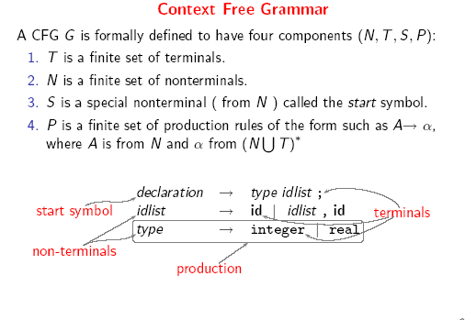
Compiler Design 40106

Slide 4
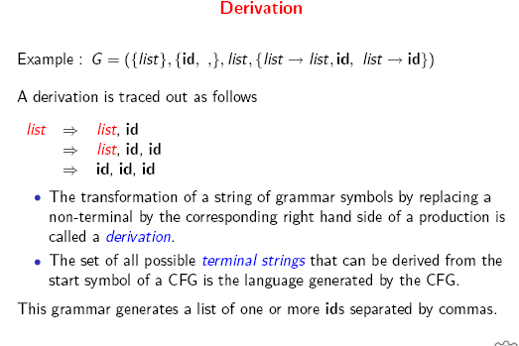
Compiler Design 40106

Slide 5
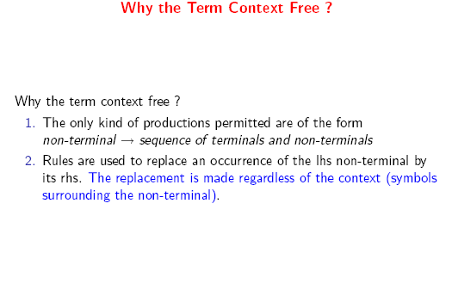
Compiler Design 40106

Slide 6
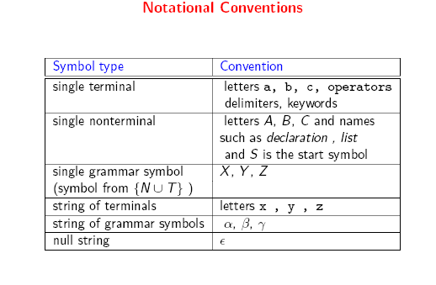
Compiler Design 40106

Slide 7
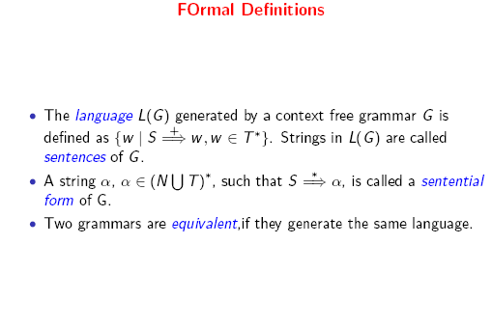
Compiler Design 40106

Slide 8
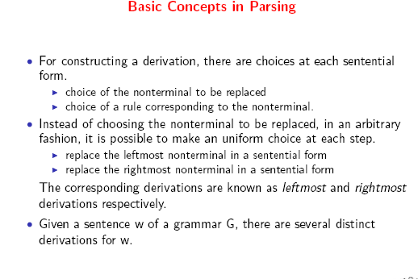
Compiler Design 40106

Slide 9
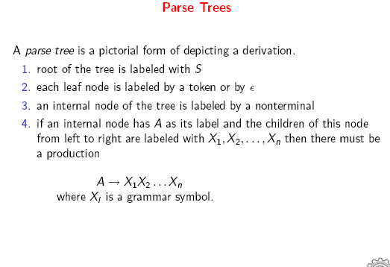
Compiler Design 40106

Slide 10
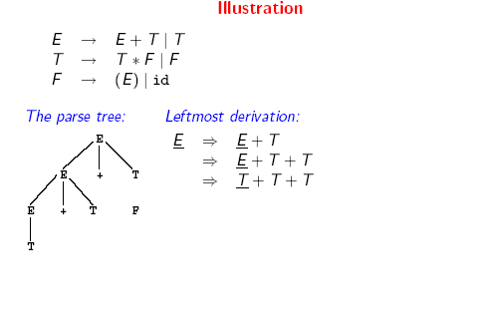
Compiler Design 40106

Slide 11
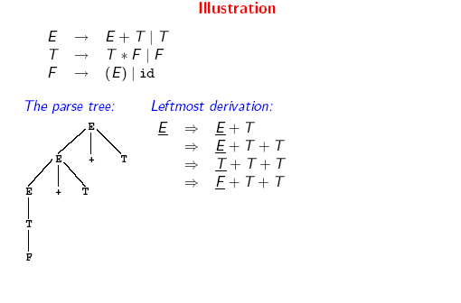
Compiler Design 40106

Slide 12
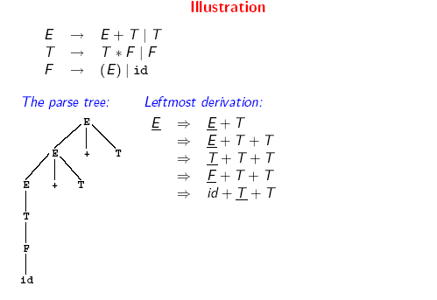
Compiler Design 40106

Slide 13
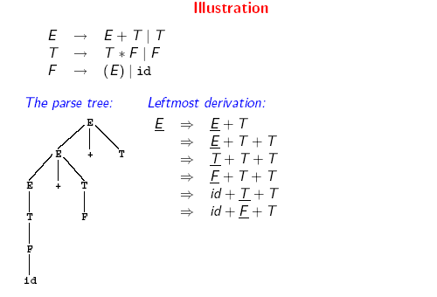
Compiler Design 40106

Slide 14
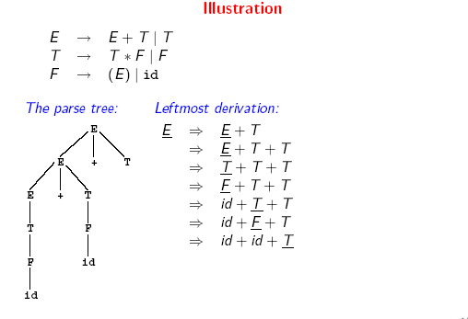
Compiler Design 40106

Slide 15
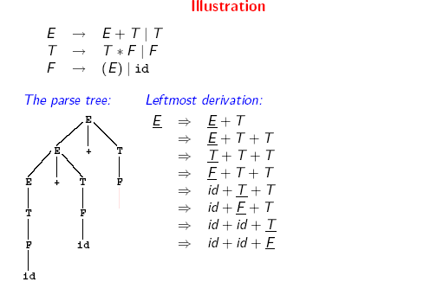
Compiler Design 40106

Slide 16
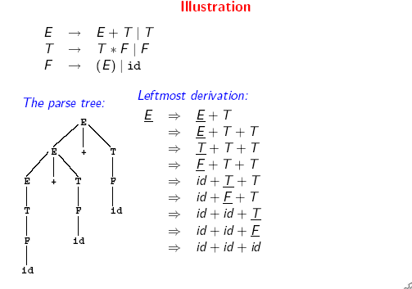
Compiler Design 40106

Slide 17
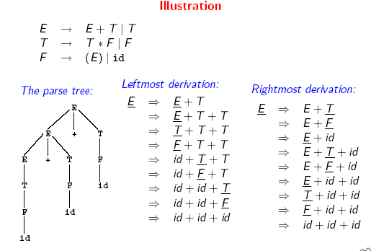
Compiler Design 40106

Slide 18
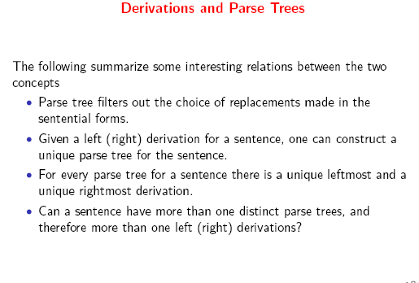
Compiler Design 40106

Slide 19
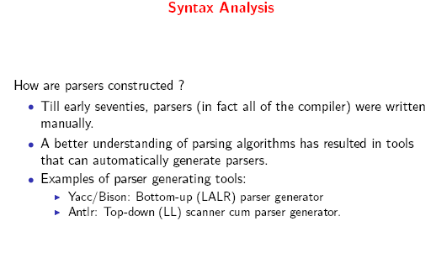
Compiler Design 40106

Slide 20
Parsers (cont.)
We categorize the parsers into two groups:
Top-Down Parser
  the parse tree is created top to bottom, starting from the root.
Bottom-Up Parser
  the parse is created bottom to top; starting from the leaves
Both top-down and bottom-up parsers scan the input from left to right (one symbol at a time).
Efficient top-down and bottom-up parsers can be implemented only for sub-classes of context-free grammars.
  LL for top-down parsing
  LR for bottom-up parsing
Compiler Design 40106

Slide 21
Ambiguity (cont.)
For the most parsers, the grammar must be unambiguous.
unambiguous grammar
➔ unique selection of the parse tree for a sentence
We should eliminate the ambiguity in the grammar during the design phase of the compiler.
An unambiguous grammar should be written to eliminate the ambiguity.
We have to prefer one of the parse trees of a sentence (generated by an ambiguous grammar) to disambiguate that grammar to restrict to this choice.
Compiler Design 40106

Slide 22
Ambiguity (cont.)
stmt → if expr then stmt |
if expr then stmt else stmt | otherstmts
if E₁ then if E₂ then S₁ else S₂
stmt
if expr then stmt else stmt
E₁ if expr then stmt S₂
E₂ S₁
stmt
if expr then stmt
E₁ if expr then stmt else stmt
E₂ S₁ S₂
1
2
Compiler Design 40106

Slide 23
Ambiguity (cont.)
We prefer the second parse tree (else matches with closest if).
So, we have to disambiguate our grammar to reflect this choice.
The unambiguous grammar will be:
stmt → matchedstmt | unmatchedstmt
matchedstmt → if expr then matchedstmt else matchedstmt | otherstmts
unmatchedstmt → if expr then stmt |
if expr then matchedstmt else unmatchedstmt
Compiler Design 40106

Slide 24
Left Recursion
A grammar is left recursive if it has a non-terminal A such that there is a derivation.
A ⇒ Aα for some string α
Top-down parsing techniques cannot handle left-recursive grammars.
So, we have to convert our left-recursive grammar into an equivalent grammar which is not left-recursive.
The left-recursion may appear in a single step of the derivation (immediate left-recursion), or may appear in more than one step of the derivation.
+
Compiler Design 40106

Slide 25
Immediate Left-Recursion
A → A α | β where β does not start with A
⇓ eliminate immediate left recursion
A → β A’
A’ → α A’ | ε an equivalent grammar
In general,
A → A α₁ | ... | A α_{m} | β₁ | ... | β_{n} where β₁ ... β_{n} do not start with A
⇓ eliminate immediate left recursion
A → β₁ A’ | ... | β_{n} A’
A’ → α₁ A’ | ... | α_{m} A’ | ε an equivalent grammar
Compiler Design 40106

Slide 26
Immediate Left-Recursion -- Example
E → E+T | T
T → T*F | F
F → id | (E)
⇓ eliminate immediate left recursion
E → T E’
E’ → +T E’ | ε
T → F T’
T’ → *F T’ | ε
F → id | (E)
Compiler Design 40106

Slide 27
Left-Factoring
A predictive parser (a top-down parser without backtracking) insists that the grammar must be left-factored.
grammar ➔ a new equivalent grammar suitable for predictive parsing
stmt → if expr then stmt else stmt |
if expr then stmt
when we see if, we cannot figure out which production rule to choose to re-write stmt in the derivation.
Compiler Design 40106

Slide 28
Left-Factoring (cont.)
In general,
A → αβ₁ | αβ₂ where α is non-empty and the first symbols
of β₁ and β₂ (if they have one)are different.
when processing α we cannot know whether expand
A to αβ₁ or
A to αβ₂
But, if we re-write the grammar as follows
A → αA’
A’ → β₁ | β₂ so, we can immediately expand A to αA’
Compiler Design 40106

Slide 29
Left-Factoring -- Algorithm
For each non-terminal A with two or more alternatives (production rules) with a common non-empty prefix, let us say
A → αβ₁ | ... | αβ_{n} | γ₁ | ... | γ_{m}
convert it into
A → αA’ | γ₁ | ... | γ_{m}
A’ → β₁ | ... | β_{n}
Compiler Design 40106

Slide 30
Left-Factoring – Example1
A → abB | aB | cdg | cdeB | cdfB
⇓
A → aA’ | cdg | cdeB | cdfB
A’ → bB | B
⇓
A → aA’ | cdA’’
A’ → bB | B
A’’ → g | eB | fB
Compiler Design 40106

Slide 31
Non-Context Free Language Constructs
There are some language constructs in the programming languages which are not context-free. This means that, we cannot write a context-free grammar for these constructs.
L1 = { ωcω | ω is in (a|b)*} is not context-free
➔ declaring an identifier and checking whether it is declared or not later. We cannot do this with a context-free language. We need semantic analyzer (which is not context-free).
L2 = {a^{n}b^{m}c^{n}d^{m} | n≥1 and m≥1 } is not context-free
➔ declaring two functions (one with n parameters, the other one with
m parameters), and then calling them with actual parameters.
Compiler Design 40106

Slide 32
Top-Down Parsing
The parse tree is created top to bottom.
Top-down parser
  Recursive-Descent Parsing
    Backtracking is needed (If a choice of a production rule does not work, we backtrack to try other alternatives.)
    It is a general parsing technique, but not widely used.
    Not efficient
  Predictive Parsing
    no backtracking
    efficient
    needs a special form of grammars (LL(1) grammars).
    Non-Recursive (Table Driven) Predictive Parser is also known as LL(1) parser.
Compiler Design 40106
Notes:
lec03-topdownparser

Slide 33
Recursive-Descent Parsing (uses Backtracking)
Backtracking is needed.
It tries to find the left-most derivation.
S → cAd
A → ab | a
S S
input: cad
c A d c A d
a b a
fails, backtrack
Compiler Design 40106

Slide 34
Predictive Parser
a grammar ➔ ➔ a grammar suitable for predictive
eliminate left parsing (a LL(1) grammar)
left recursion factor no %100 guarantee.
When re-writing a non-terminal in a derivation step, a predictive parser can uniquely choose a production rule by just looking the current symbol in the input string.
A → α₁ | ... | α_{n} input: ... a .......
current token
Compiler Design 40106

Slide 35
Predictive Parser (example)
stmt → if ...... |
while ...... |
begin ...... |
for .....
When we are trying to write the non-terminal stmt, if the current token is if we have to choose first production rule.
When we are trying to write the non-terminal stmt, we can uniquely choose the production rule by just looking the current token.
We eliminate the left recursion in the grammar, and left factor it. But it may not be suitable for predictive parsing (not LL(1) grammar).
Compiler Design 40106

Slide 36
Recursive Predictive Parsing
Each non-terminal corresponds to a procedure.
Ex: A → aBb (This is only the production rule for A)
proc A {
- match the current token with a, and move to the next token;
- call ‘B’;
- match the current token with b, and move to the next token;
}
Compiler Design 40106

Slide 37
Recursive Predictive Parsing (Example)
A → aBe | cBd | C
B → bB | ε
C → f
Compiler Design 40106

Slide 38
Non-Recursive Predictive Parsing -- LL(1) Parser
Non-Recursive predictive parsing is a table-driven parser.
It is a top-down parser.
It is also known as LL(1) Parser.
input buffer
stack Non-recursive output
Predictive Parser
Parsing Table
Compiler Design 40106

Slide 39
LL(1) Parser
input buffer
  our string to be parsed. We will assume that its end is marked with a special symbol $.
output
  a production rule representing a step of the derivation sequence (left-most derivation) of the string in the input buffer.
stack
  contains the grammar symbols
  at the bottom of the stack, there is a special end marker symbol $.
  initially the stack contains only the symbol $ and the starting symbol S. $S ⬅ initial stack
  when the stack is emptied (ie. only $ left in the stack), the parsing is completed.
parsing table
  a two-dimensional array M[A,a]
  each row is a non-terminal symbol
  each column is a terminal symbol or the special symbol $
  each entry holds a production rule.
Compiler Design 40106

Slide 40
LL(1) Parser – Parser Actions
The symbol at the top of the stack (say X) and the current symbol in the input string (say a) determine the parser action.
There are four possible parser actions.
If X and a are $ ➔ parser halts (successful completion)
If X and a are the same terminal symbol (different from $)
➔ parser pops X from the stack, and moves to the next symbol in the input buffer.
If X is a non-terminal
➔ parser looks at the parsing table entry M[X,a]. If M[X,a] holds a production rule X→Y₁Y₂...Y_{k}, it pops X from the stack and pushes Y_{k},Y_{k-1},...,Y₁ into the stack. The parser also outputs the production rule X→Y₁Y₂...Y_{k} to represent a step of the derivation.
none of the above ➔ error
  all empty entries in the parsing table are errors.
  If X is a terminal symbol different from a, this is also an error case.
Compiler Design 40106

Slide 41
LL(1) Parser – Example1
S → aBa LL(1) Parsing
B → bB | ε Table
stack input output
$S abba$ S → aBa
$aBa abba$
$aB bba$ B → bB
$aBb bba$
$aB ba$ B → bB
$aBb ba$
$aB a$ B → ε
$a a$
$ $ accept, successful completion
 | a | b | $
S | S → aBa
B | B → ε | B → bB
Compiler Design 40106

Slide 42
LL(1) Parser – Example1 (cont.)
Outputs: S → aBa B → bB B → bB B → ε
Derivation(left-most): S⇒aBa⇒abBa⇒abbBa⇒abba
S
parse tree
a
B
a
b
B
b
B
ε
Compiler Design 40106

Slide 43
LL(1) Parser – Example2
E → TE’
E’ → +TE’ | ε
T → FT’
T’ → *FT’ | ε
F → (E) | id
 | id | + | * | ( | ) | $
E | E → TE’ |  |  | E → TE’
E’ |  | E’ → +TE’ |  |  | E’ → ε | E’ → ε
T | T → FT’ |  |  | T → FT’
T’ |  | T’ → ε | T’ → *FT’ |  | T’ → ε | T’ → ε
F | F → id |  |  | F → (E)
Compiler Design 40106

Slide 44
LL(1) Parser – Example2
stack input output
$E id+id$ E → TE’
$E’T id+id$ T → FT’
$E’ T’F id+id$ F → id
$ E’ T’id id+id$
$ E’ T’ +id$ T’ → ε
$ E’ +id$ E’ → +TE’
$ E’ T+ +id$
$ E’ T id$ T → FT’
$ E’ T’ F id$ F → id
$ E’ T’id id$
$ E’ T’ $ T’ → ε
$ E’ $ E’ → ε
$ $ accept
Compiler Design 40106

Slide 45
Constructing LL(1) Parsing Tables
Two functions are used in the construction of LL(1) parsing tables:
  FIRST FOLLOW
FIRST(α) is a set of the terminal symbols which occur as first symbols in the strings derived from α where α is any string of grammar symbols.
if α derives to ε, then ε is also in FIRST(α) .
FOLLOW(A) is the set of the terminals which occur immediately after (follow) the non-terminal A in the strings derived from the starting symbol.
  a terminal a is in FOLLOW(A) if S ⇒ αAaβ
*
Compiler Design 40106

Slide 46
Compute FIRST for Any String X
If X is a terminal symbol ➔ FIRST(X)={X}
If X is a non-terminal symbol and X → ε is a production rule ➔ ε is in FIRST(X).
If X is a non-terminal symbol and X → Y₁Y₂..Y_{n} is a production rule ➔ if a terminal a in FIRST(Y_{i}) and ε is in all FIRST( Y_{j} ) for j=1,...,i-1 then a is in FIRST(X).
➔ if ε is in all FIRST(Y_{j}) for j=1,...,n then ε is in FIRST(X).
Compiler Design 40106

Slide 47
FIRST Example
E → TE’
E’ → +TE’ | ε
T → FT’
T’ → *FT’ | ε
F → (E) | id
FIRST(F) = {(,id} FIRST(TE’) = {(,id}
FIRST(T’) = {*, ε} FIRST(+TE’ ) = {+}
FIRST(T) = {(,id} FIRST(ε) = {ε}
FIRST(E’) = {+, ε} FIRST(FT’) = {(,id}
FIRST(E) = {(,id} FIRST(*FT’) = {*}
FIRST(ε) = {ε}
FIRST((E)) = {(}
FIRST(id) = {id}
Compiler Design 40106

Slide 48
Compute FOLLOW (for non-terminals)
If S is the start symbol ➔ $ is in FOLLOW(S)
if A → αBβ is a production rule ➔ everything in FIRST(β) is FOLLOW(B) except ε
If ( A → αB is a production rule ) or ( A → αBβ is a production rule and ε is in FIRST(β) ) ➔ everything in FOLLOW(A) is in FOLLOW(B).
We apply these rules until nothing more can be added to any follow set.
Compiler Design 40106

Slide 49
FOLLOW Example
E → TE’
E’ → +TE’ | ε
T → FT’
T’ → *FT’ | ε
F → (E) | id
FOLLOW(E) = { $, ) }
FOLLOW(E’) = { $, ) }
FOLLOW(T) = { +, ), $ }
FOLLOW(T’) = { +, ), $ }
FOLLOW(F) = {+, *, ), $ }
Compiler Design 40106

Slide 50
Constructing LL(1) Parsing Table -- Algorithm
for each production rule A → α of a grammar G
  for each terminal a in FIRST(α) ➔ add A → α to M[A,a]
  If ε in FIRST(α) ➔ for each terminal a in FOLLOW(A) add A → α to M[A,a]
  If ε in FIRST(α) and $ in FOLLOW(A) ➔ add A → α to M[A,$]
All other undefined entries of the parsing table are error entries.
Compiler Design 40106

Slide 51
Constructing LL(1) Parsing Table -- Example
E → TE’ FIRST(TE’)={(,id} ➔ E → TE’ into M[E,(] and M[E,id]
E’ → +TE’ FIRST(+TE’ )={+} ➔ E’ → +TE’ into M[E’,+]
E’ → ε FIRST(ε)={ε} ➔ none
but since ε in FIRST(ε)
and FOLLOW(E’)={$,)} ➔ E’ → ε into M[E’,$] and M[E’,)]
T → FT’ FIRST(FT’)={(,id} ➔ T → FT’ into M[T,(] and M[T,id]
T’ → *FT’ FIRST(*FT’ )={*} ➔ T’ → *FT’ into M[T’,*]
T’ → ε FIRST(ε)={ε} ➔ none
but since ε in FIRST(ε)
and FOLLOW(T’)={$,),+} ➔ T’ → ε into M[T’,$], M[T’,)] and M[T’,+]
F → (E) FIRST((E) )={(} ➔ F → (E) into M[F,(]
F → id FIRST(id)={id} ➔ F → id into M[F,id]
Compiler Design 40106

Slide 52
LL(1) Grammars
A grammar whose parsing table has no multiply-defined entries is said to be LL(1) grammar.
one input symbol used as a lookahead symbol do determine parser action
LL(1) left most derivation
input scanned from left to right
The parsing table of a grammar may contain more than one production rule. In this case, we say that it is not a LL(1) grammar.
Compiler Design 40106

Slide 53
A Grammar which is not LL(1)
S → i C t S E | a FOLLOW(S) = { $,e }
E → e S | ε FOLLOW(E) = { $,e }
C → b FOLLOW(C) = { t }
FIRST(iCtSE) = {i}
FIRST(a) = {a}
FIRST(eS) = {e}
FIRST(ε) = {ε}
FIRST(b) = {b}
two production rules for M[E,e]
Problem ➔ ambiguity
 | a | b | e | i | t | $
S | S → a |  |  | S → iCtSE
E |  |  | E → e S E → ε |  |  | E → ε
C |  | C → b
Compiler Design 40106

Slide 54
Properties of LL(1) Grammars
A grammar G is LL(1) if and only if the following conditions hold for two distinctive production rules A → α and A → β
  Both α and β cannot derive strings starting with same terminals.
  At most one of α and β can derive to ε.
  If β can derive to ε, then α cannot derive to any string starting with a terminal in FOLLOW(A).
Compiler Design 40106

Slide 55
Error Recovery in Predictive Parsing
An error may occur in the predictive parsing (LL(1) parsing)
  if the terminal symbol on the top of stack does not match with the current input symbol.
  if the top of stack is a non-terminal A, the current input symbol is a, and the parsing table entry M[A,a] is empty.
What should the parser do in an error case?
  The parser should be able to give an error message (as much as possible meaningful error message).
  It should be recover from that error case, and it should be able to continue the parsing with the rest of the input.
Compiler Design 40106

Slide 56
Error Recovery Techniques
Panic-Mode Error Recovery
  Skipping the input symbols until a synchronizing token is found.
Phrase-Level Error Recovery
  Each empty entry in the parsing table is filled with a pointer to a specific error routine to take care of that error case.
Error-Productions
  If we have a good idea of the common errors that might be encountered, we can augment the grammar with productions that generate erroneous constructs.
  When an error production is used by the parser, we can generate appropriate error diagnostics.
  Since it is almost impossible to know all the errors that can be made by the programmers, this method is not practical.
Compiler Design 40106

Slide 57
Panic-Mode Error Recovery in LL(1) Parsing
In panic-mode error recovery, we skip all the input symbols until a synchronizing token is found.
What is the synchronizing token?
  All the terminal-symbols in the follow set of a non-terminal can be used as a synchronizing token set for that non-terminal.
So, a simple panic-mode error recovery for the LL(1) parsing:
  All the empty entries are marked as synch to indicate that the parser will skip all the input symbols until a symbol in the follow set of the non-terminal A which is on the top of the stack. Then the parser will pop that non-terminal A from the stack. The parsing continues from that state.
  To handle unmatched terminal symbols, the parser pops that unmatched terminal symbol from the stack and it issues an error message saying that unmatched terminal is inserted.
Compiler Design 40106

Slide 58
Panic-Mode Error Recovery - Example
S → AbS | e | ε
A → a | cAd
Compiler Design 40106

Slide 59
Panic-Mode Error Recovery - Example
 | a | b | c | d | e | $
S | S → AbS | sync | S → AbS | sync | S → e | S → ε
A | A → a | sync | A → cAd | sync | sync | sync
S → AbS | e | ε
A → a | cAd
FOLLOW(S)={$}
FOLLOW(A)={b,d}
stack input output stack input output
$S aab$ S → AbS $S ceadb$ S → AbS
$SbA aab$ A → a $SbA ceadb$ A → cAd
$Sba aab$ $SbdAc ceadb$
$Sb ab$ Error: missing b, inserted $SbdA eadb$ Error:unexpected e (illegal A)
$S ab$ S → AbS (Remove all input tokens until first b or d, pop A)
$SbA ab$ A → a $Sbd db$
$Sba ab$ $Sb b$
$Sb b$ $S $ S → ε
$S $ S → ε $ $ accept
$ $ accept
Compiler Design 40106

Slide 60
Phrase-Level Error Recovery
Each empty entry in the parsing table is filled with a pointer to a special error routine which will take care of that error case.
These error routines may:
  change, insert, or delete input symbols.
  issue appropriate error messages
  pop items from the stack.
We should be careful when we design these error routines, because we may put the parser into an infinite loop.
Compiler Design 40106

Slide 61
Bottom-Up Parsing
A bottom-up parser creates the parse tree of the given input starting from leaves towards the root.
A bottom-up parser tries to find the right-most derivation of the given input in the reverse order.
  S ⇒ ... ⇒ ω (the right-most derivation of ω)
  ← (the bottom-up parser finds the right-most derivation in the reverse order)
Bottom-up parsing is also known as shift-reduce parsing because its two main actions are shift and reduce.
  At each shift action, the current symbol in the input string is pushed to a stack.
  At each reduction step, the symbols at the top of the stack (this symbol sequence is the right side of a production) will be replaced by the non-terminal at the left side of that production.
  There are also two more actions: accept and error.
Compiler Design 40106
Notes:
lec04-bottomupparser

Slide 62
Shift-Reduce Parsing
A shift-reduce parser tries to reduce the given input string into the starting symbol.
  a string ➔ the starting symbol
  reduced to
At each reduction step, a substring of the input matching to the right side of a production rule is replaced by the non-terminal at the left side of that production rule.
If the substring is chosen correctly, the right most derivation of that string is created in the reverse order.
Rightmost Derivation: S ⇒ ω
Shift-Reduce Parser finds: ω ⇐ ... ⇐ S
*
rm
rm
rm
Compiler Design 40106

Slide 63
Shift-Reduce Parsing -- Example
S → aABb input string: aaabb
A → aA | a aaAbb
B → bB | b aAbb ⇓ reduction
aABb
S
S ⇒ aABb ⇒ aAbb ⇒ aaAbb ⇒ aaabb
Right Sentential Forms
How do we know which substring to be replaced at each reduction step?
rm
rm
rm
rm
Compiler Design 40106

Slide 64
Handle
Informally, a handle of a string is a substring that matches the right side of a production rule.
  But not every substring matches the right side of a production rule is handle
A handle of a right sentential form γ (≡ αβω) is
a production rule A → β and a position of γ
where the string β may be found and replaced by A to produce
the previous right-sentential form in a rightmost derivation of γ.
S ⇒ αAω ⇒ αβω
If the grammar is unambiguous, then every right-sentential form of the grammar has exactly one handle.
We will see that ω is a string of terminals.(the string ω to the right of handle contains only terminal symbols.)
*
rm
rm
Compiler Design 40106

Slide 65
A Shift-Reduce Parser
E → E+T | T
T → T*F | F
F → (E) | id
Right-Most Sentential Form Reducing Production
id+id*id F → id
F+id*id T → F
---- ----
----- ----
----- -----
---- -----
Handles are red and underlined in the right-sentential forms.
Compiler Design 40106

Slide 66
A Shift-Reduce Parser
E → E+T | T Right-Most Derivation of id+id*id
T → T*F | F E ⇒ E+T ⇒ E+T*F ⇒ E+T*id ⇒ E+F*id
F → (E) | id ⇒ E+id*id ⇒ T+id*id ⇒ F+id*id ⇒ id+id*id
Right-Most Sentential Form Reducing Production
id+id*id F → id
F+id*id T → F
T+id*id E → T
E+id*id F → id
E+F*id T → F
E+T*id F → id
E+T*F T → T*F
E+T E → E+T
E
Handles are red and underlined in the right-sentential forms.
Compiler Design 40106

Slide 67
A Stack Implementation of A Shift-Reduce Parser
There are four possible actions of a shift-parser action:
  Shift : The next input symbol is shifted onto the top of the stack.
  Reduce: Replace the handle on the top of the stack by the non-terminal.
  Accept: Successful completion of parsing.
  Error: Parser discovers a syntax error, and calls an error recovery routine.
Initial stack just contains only the end-marker $.
The end of the input string is marked by the end-marker $.
Compiler Design 40106

Slide 68
A Stack Implementation of A Shift-Reduce Parser
Stack Input Action
$ id+id*id$ shift
$id +id*id$ reduce by F → id Parse Tree
$F +id*id$ reduce by T → F
$T +id*id$ reduce by E → T E 8
$E +id*id$ shift
$E+ id*id$ shift E 3 + T 7
$E+id *id$ reduce by F → id
$E+F *id$ reduce by T → F T 2 T 5 * F 6
$E+T *id$ shift
$E+T* id$ shift F 1 F 4 id
$E+T*id $ reduce by F → id
$E+T*F $ reduce by T → T*F id id
$E+T $ reduce by E → E+T
$E $ accept
Compiler Design 40106
Notes:
Grammer:
E->E+T|T
T->T*F|F
F->id
lec02-parserCFG

Slide 69
LR Parsers
The most powerful shift-reduce parsing (yet efficient) is:
LR(k) parsing.
left to right right-most k lookhead
scanning derivation in reverse (k is omitted ➔ it is 1)
LR parsing is attractive because:
  LR parsing is most general non-backtracking shift-reduce parsing.
  The class of grammars that can be parsed using LR methods is a proper superset of the class of grammars that can be parsed with predictive parsers. LL(1)-Grammars ⊂ LR(1)-Grammars
  An LR-parser can detect a syntactic error as soon as it is possible to do so a left-to-right scan of the input.
  LR parsers recognize virtually all programming-language constructs for which CFG can be written.
Compiler Design 40106

Slide 70
LR Parsers
LR-Parsers
  covers wide range of grammars.
  SLR – simple LR parser
  LR(CLR) – most general LR parser
  LALR – intermediate LR parser (look-head LR parser)
  SLR, CLR and LALR work same (they used the same algorithm), only their parsing tables are different.
Compiler Design 40106

Slide 71
LR Parsing Algorithm
input
a₁ | ... | a_{i} | ... | a_{n} | $
stack
S_{m}
X_{m}
S_{m-1}
X_{m-1}
.
.
S₁
X₁
S₀
LR Parsing Algorithm
output
Action Table terminals and $ s t four different a actions t e s | Goto Table non-terminal s t each item is a a state number t e s
Compiler Design 40106

Slide 72
A Configuration of LR Parsing Algorithm
A configuration of a LR parsing is:
( S_{o} X₁ S₁ ... X_{m} S_{m}, a_{i} a_{i+1} ... a_{n} $ )
Stack Rest of Input
S_{m} and a_{i} decides the parser action by consulting the parsing action table. (Initial Stack contains just S_{o} )
A configuration of a LR parsing represents the right sentential form:
X₁ ... X_{m} a_{i} a_{i+1} ... a_{n} $
Compiler Design 40106

Slide 73
Actions of A LR-Parser
shift s -- shifts the next input symbol and the state s onto the stack
( S_{o} X₁ S₁ ... X_{m} S_{m}, a_{i} a_{i+1} ... a_{n} $ ) ➔ ( S_{o} X₁ S₁ ... X_{m} S_{m} a_{i} s, a_{i+1} ... a_{n} $ )
reduce A→β (or r_{n} where n is a production number)
  pop 2|β| (r is the length of β) items from the stack;
  then push A and s where s=goto[s_{m-r},A]
( S_{o} X₁ S₁ ... X_{m} S_{m}, a_{i} a_{i+1} ... a_{n} $ ) ➔ ( S_{o} X₁ S₁ ... X_{m-r} S_{m-r} A s, a_{i} ... a_{n} $ )
  Output is the reducing production reduce A→β
Accept – Parsing successfully completed
Error -- Parser detected an error (an empty entry in the action table)
Compiler Design 40106

Slide 74
Reduce Action
pop 2|β| (r is the length of β ) items from the stack;
let us assume that β = Y₁Y₂...Y_{r}
then push A and s where s=goto[s_{m-r},A]
( S_{o} X₁ S₁ ... X_{m-r} S_{m-r} Y₁ S_{m-r+1} ...Y_{r} S_{m}, a_{i} a_{i+1} ... a_{n} $ )
➔ ( S_{o} X₁ S₁ ... X_{m-r} S_{m-r} A s, a_{i} ... a_{n} $ )
In fact, Y₁Y₂...Y_{r} is a handle.
X₁ ... X_{m-r} A a_{i} ... a_{n} $ ⇒ X₁ ... X_{m} Y₁...Y_{r} a_{i} a_{i+1} ... a_{n} $
Compiler Design 40106

Slide 75
The LR parsing algorithm
At each step, the parser is in some configuration.
The next move depends on reading a_{i} from the input and s_{m} from the top of the stack.
  If action[s_{m},a_{i}] = shift s, we execute a SHIFT move, entering the configuration ( s₀ X₁ s₁ … X_{m} s_{m} a_{i} s, a_{i+1} … a_{n} $ ).
  If action[s_{m},a_{i}] = reduce A -> β, then we enter the configuration
  ( s₀ X₁ s₁ … X_{m-r} s_{m-r} A s, a_{i+1} … a_{n} $ ),
  where r = | β | and s = goto[s_{m-r},A].
  Output the production A → β
  If action[s_{m},a_{i}] = accept, we’re done.
  If action[s_{m},a_{i}] = error, we call an error recovery routine.
Compiler Design 40106

Slide 76
(SLR) Parsing Tables for Expression Grammar
Action Table
Goto Table
1) E → E+T
2) E → T
3) T → T*F
4) T → F
5) F → (E)
6) F → id
state | id | + | * | ( | ) | $ |  | E | T | F
0 | s5 |  |  | s4 |  |  |  | 1 | 2 | 3
1 |  | s6 |  |  |  | acc
2 |  | r2 | s7 |  | r2 | r2
3 |  | r4 | r4 |  | r4 | r4
4 | s5 |  |  | s4 |  |  |  | 8 | 2 | 3
5 |  | r6 | r6 |  | r6 | r6
6 | s5 |  |  | s4 |  |  |  |  | 9 | 3
7 | s5 |  |  | s4 |  |  |  |  |  | 10
8 |  | s6 |  |  | s11
9 |  | r1 | s7 |  | r1 | r1
10 |  | r3 | r3 |  | r3 | r3
11 |  | r5 | r5 |  | r5 | r5
Compiler Design 40106

Slide 77
Actions of A (S)LR-Parser -- Example
stack input action output
0 id*id+id$ shift 5
0id5 *id+id$ reduce by F→id F→id
0F3 *id+id$ reduce by T→F T→F
0T2 *id+id$ shift 7
0T2*7 id+id$ shift 5
0T2*7id5 +id$ reduce by F→id F→id
0T2*7F10 +id$ reduce by T→T*F T→T*F
0T2 +id$ reduce by E→T E→T
0E1 +id$ shift 6
0E1+6 id$ shift 5
0E1+6id5 $ reduce by F→id F→id
0E1+6F3 $ reduce by T→F T→F
0E1+6T9 $ reduce by E→E+T E→E+T
0E1 $ accept
Compiler Design 40106

Slide 78
Constructing SLR Parsing Tables – LR(0) Item
An LR(0) item of a grammar G is a production of G a dot at the some position of the right side.
Ex: A → aBb Possible LR(0) Items: A → .aBb
(four different possibility) A → a.Bb
A → aB.b
A → aBb.
Sets of LR(0) items will be the states of action and goto table of the SLR parser.
A collection of sets of LR(0) items (the canonical LR(0) collection) is the basis for constructing SLR parsers.
Augmented Grammar:
G’ is G with a new production rule S’→S where S’ is the new starting symbol.
Compiler Design 40106

Slide 79
The Closure Operation
If I is a set of LR(0) items for a grammar G, then closure(I) is the set of LR(0) items constructed from I by the two rules:
  Initially, every LR(0) item in I is added to closure(I).
  If A → α.Bβ is in closure(I) and B→γ is a production rule of G; then B→.γ will be in the closure(I). We will apply this rule until no more new LR(0) items can be added to closure(I).
Compiler Design 40106

Slide 80
The Closure Operation -- Example
E’ → E closure({E’ → .E}) = ?
E → E+T
E → T
T → T*F
T → F
F → (E)
F → id
Compiler Design 40106

Slide 81
The Closure Operation -- Example
E’ → E closure({E’ → .E}) =
E → E+T { E’ → .E kernel items
E → T E → .E+T
T → T*F E → .T
T → F T → .T*F
F → (E) T → .F
F → id F → .(E)
F → .id }
Compiler Design 40106

Slide 82
Goto Operation
If I is a set of LR(0) items and X is a grammar symbol (terminal or non-terminal), then goto(I,X) is defined as follows:
  If A → α.Xβ in I then every item in closure({A → αX.β}) will be in goto(I,X).
Example:
I ={ E’ → .E, E → .E+T, E → .T,
T → .T*F, T → .F,
F → .(E), F → .id }
goto(I,E) = { ----------}
goto(I,T) = { -----------}
goto(I,F) = {------------}
goto(I,() = { ---------- }
goto(I,id) = {----------}
Compiler Design 40106

Slide 83
Goto Operation
If I is a set of LR(0) items and X is a grammar symbol (terminal or non-terminal), then goto(I,X) is defined as follows:
  If A → α.Xβ in I then every item in closure({A → αX.β}) will be in goto(I,X).
Example:
I ={ E’ → .E, E → .E+T, E → .T,
T → .T*F, T → .F,
F → .(E), F → .id }
goto(I,E) = { E’ → E., E → E.+T }
goto(I,T) = { E → T., T → T.*F }
goto(I,F) = {T → F. }
goto(I,() = { F → (.E), E → .E+T, E → .T, T → .T*F, T → .F,
F → .(E), F → .id }
goto(I,id) = { F → id. }
Compiler Design 40106

Slide 84
Construction of The Canonical LR(0) Collection
To create the SLR parsing tables for a grammar G, we will create the canonical LR(0) collection of the grammar G’.
Algorithm:
  C is { closure({S’→.S}) }
  repeat the followings until no more set of LR(0) items can be added to C.
    for each I in C and each grammar symbol X
      if goto(I,X) is not empty and not in C
        add goto(I,X) to C
goto function is a DFA on the sets in C.
Compiler Design 40106

Slide 85
The Canonical LR(0) Collection -- Example
I₀: E’ → .E I₆: E → E+.T I₉: E → E+T.
E → .E+T T → .T*F T → T.*F
E → .T T → .F
T → .T*F I₂: E → T. F → .(E) I₁₀: T → T*F.
T → .F T → T.*F F → .id
F → .(E)
F → .id I₃: T → F. I₇: T → T*.F I₁₁: F → (E).
F → .(E)
I₁: E’ → E. I₄: F → (.E) F → .id
E → E.+T E → .E+T
E → .T I₈: F → (E.)
T → .T*F E → E.+T
T → .F
F → .(E)
F → .id
I₅: F → id.
Compiler Design 40106

Slide 86
Parsing Tables of Expression Grammar
Action Table
Goto Table
state | id | + | * | ( | ) | $ |  | E | T | F
0 | s5 |  |  | s4 |  |  |  | 1 | 2 | 3
1 |  | s6 |  |  |  | acc
2 |  | r2 | s7 |  | r2 | r2
3 |  | r4 | r4 |  | r4 | r4
4 | s5 |  |  | s4 |  |  |  | 8 | 2 | 3
5 |  | r6 | r6 |  | r6 | r6
6 | s5 |  |  | s4 |  |  |  |  | 9 | 3
7 | s5 |  |  | s4 |  |  |  |  |  | 10
8 |  | s6 |  |  | s11
9 |  | r1 | s7 |  | r1 | r1
10 |  | r3 | r3 |  | r3 | r3
11 |  | r5 | r5 |  | r5 | r5
Compiler Design 40106

Slide 87
SLR(1) Grammar
An LR parser using SLR parsing tables for a grammar G is called as the SLR parser for G.
If a grammar G has an SLR parsing table, it is called SLR grammar (or SLR grammar in short).
Every SLR grammar is unambiguous, but every unambiguous grammar is not a SLR grammar.
Compiler Design 40106

Slide 88
Conflict Example
S → L=R I₀: S’ → .S I₁: S’ → S. I₆: S → L=.R I₉: S → L=R.
S → R S → .L=R R → .L
L→ *R S → .R I₂: S → L.=R L→ .*R
L → id L → .*R R → L. L → .id
R → L L → .id
R → .L I₃: S → R.
I₄: L → *.R I₇: L → *R.
Problem R → .L
FOLLOW(R)={=,$} L→ .*R I₈: R → L.
= shift 6 L → .id
reduce by R → L
shift/reduce conflict I₅: L → id.
Compiler Design 40106

Slide 89
Conflict Example2
S → AaAb I₀: S’ → .S
S → BbBa S → .AaAb
A → ε S → .BbBa
B → ε A → .
B → .
Problem
FOLLOW(A)={a,b}
FOLLOW(B)={a,b}
a reduce by A → ε b reduce by A → ε
reduce by B → ε reduce by B → ε
reduce/reduce conflict reduce/reduce conflict
Compiler Design 40106

Slide 90
Canonical Collection of Sets of LR(1) Items
The construction of the canonical collection of the sets of LR(1) items are similar to the construction of the canonical collection of the sets of LR(0) items, except that closure and goto operations work a little bit different.
closure(I) is: ( where I is a set of LR(1) items)
  every LR(1) item in I is in closure(I)
  if A→α.Bβ,a in closure(I) and B→γ is a production rule of G; then B→.γ,b will be in the closure(I) for each terminal b in FIRST(βa) .
Compiler Design 40106

Slide 91
goto operation
If I is a set of LR(1) items and X is a grammar symbol (terminal or non-terminal), then goto(I,X) is defined as follows:
  If A → α.Xβ,a in I then every item in closure({A → αX.β,a}) will be in goto(I,X).
Compiler Design 40106

Slide 92
Construction of The Canonical LR(1) Collection
Algorithm:
  C is { closure({S’→.S,$}) }
  repeat the followings until no more set of LR(1) items can be added to C.
    for each I in C and each grammar symbol X
      if goto(I,X) is not empty and not in C
        add goto(I,X) to C
goto function is a DFA on the sets in C.
Compiler Design 40106

Slide 93
A Short Notation for The Sets of LR(1) Items
A set of LR(1) items containing the following items
A → α.β,a₁
...
A → α.β,a_{n}
can be written as
A → α.β,a₁/a₂/.../a_{n}
Compiler Design 40106

Slide 94
Canonical LR(1) Collection – Example 1
S → AaAb I₀: S’ → .S ,$ I₁: S’ → S. ,$
S → BbBa S → .AaAb ,$
A → ε S → .BbBa ,$ I₂: S → A.aAb ,$
B → ε A → . ,a
B → . ,b I₃: S → B.bBa ,$
I₄: S → Aa.Ab ,$ I₆: S → AaA.b ,$ I₈: S → AaAb. ,$
A → . ,b
I₅: S → Bb.Ba ,$ I₇: S → BbB.a ,$ I₉: S → BbBa. ,$
B → . ,a
S
A
a
to I₄
B
b
to I₅
A
a
B
b
Compiler Design 40106

Slide 95
Canonical LR(1) Collection – Example2
S’ → S
1) S → L=R
2) S → R
3) L→ *R
4) L → id
5) R → L
I₀:S’ → .S,$
S → .L=R,$
S → .R,$
L → .*R,$/=
L → .id,$/=
R → .L,$
I₁:S’ → S.,$
I₄:L → *.R,$/=
R → .L,$/=
L→ .*R,$/=
L → .id,$/=
R
to I₇
S
*
L
I₂:S → L.=R,$
R → L.,$
to I₆
to I₈
L
*
to I₄
id
R
to I₅
I₃:S → R.,$
id
I₅:L → id.,$/=
I₉:S → L=R.,$
I₁₀:R → L.,$
I₁₁:L → *.R,$
R → .L,$
L→ .*R,$
L → .id,$
I₁₂:L → id.,$
R
I₁₃:L → *R.,$
I₆:S → L=.R,$
R → .L,$
L → .*R,$
L → .id,$
to I₉
L
to I₁₀
*
to I₁₁
R
to I₁₃
id
L
to I₁₂
to I₁₀
I₇:L → *R.,$/=
*
to I₁₁
id
I₈: R → L.,$/=
to I₁₂
Compiler Design 40106

Slide 96
Canonical LR(1) Collection – Example2
S’ → S
1) S → L=R
2) S → R
3) L→ *R
4) L → id
5) R → L
I₀:S’ → .S,$
S → .L=R,$
S → .R,$
L → .*R,$/=
L → .id,$/=
R → .L,$
I₁:S’ → S.,$
I₄:L → *.R,$/=
R → .L,$/=
L→ .*R,$/=
L → .id,$/=
R
to I₇
S
*
L
I₂:S → L.=R,$
R → L.,$
to I₆
to I₈
L
*
to I₄
id
R
to I₅
I₃:S → R.,$
id
I₅:L → id.,$/=
I₉:S → L=R.,$
I₁₀:R → L.,$
I₁₁:L → *.R,$
R → .L,$
L→ .*R,$
L → .id,$
I₁₂:L → id.,$
R
I₁₃:L → *R.,$
I₆:S → L=.R,$
R → .L,$
L → .*R,$
L → .id,$
to I₉
L
to I₁₀
*
I₄ and I₁₁
I₅ and I₁₂
I₇ and I₁₃
I₈ and I₁₀
to I₁₁
R
to I₁₃
id
L
to I₁₂
to I₁₀
I₇:L → *R.,$/=
*
to I₁₁
id
I₈: R → L.,$/=
to I₁₂
Compiler Design 40106

Slide 97
LR(1) Parsing Tables – (for Example2)
 | id | * | = | $ | S | L | R
0 | s5 | s4 |  |  | 1 | 2 | 3
1 |  |  |  | acc
2 |  |  | s6 | r5
3 |  |  |  | r2
4 | s5 | s4 |  |  |  | 8 | 7
5 |  |  | r4 | r4
6 | s12 | s11 |  |  |  | 10 | 9
7 |  |  | r3 | r3
8 |  |  | r5 | r5
9 |  |  |  | r1
10 |  |  |  | r5
11 | s12 | s11 |  |  |  | 10 | 13
12 |  |  |  | r4
13 |  |  |  | r3
no shift/reduce or
no reduce/reduce conflict
⇓
so, it is a LR(1) grammar
Compiler Design 40106

Slide 98
An Example-3
1. S’ → S
2. S → C C
3. C → c C
4. C → d
I₀: closure({(S’ → • S, $)}) =
(S’ → • S, $)
(S → • C C, $)
(C → • c C, c/d)
(C → • d, c/d)
I₁: goto(I₀, S) = (S’ → S • , $)
I₂: goto(I₀, C) =
(S → C • C, $)
(C → • c C, $)
(C → • d, $)
I₃: goto(I₀, c) =
(C → c • C, c/d)
(C → • c C, c/d)
(C → • d, c/d)
I₄: goto(I₀, d) =
(C → d •, c/d)
I₅: goto(I₂, C) =
(S → C C •, $)

Slide 99
An Example
I₆: goto(I₂, c) =
(C → c • C, $)
(C → • c C, $)
(C → • d, $)
I₇: goto(I₂, d) =
(C → d •, $)
I₈: goto(I₃, C) =
(C → c C •, c/d)
: goto(I₃, c) = I₃
: goto(I₃, d) = I₄
I₉: goto(I₆ c) =
(C → c C •, $)
: goto(I₆, c) = I₆
: goto(I₆, d) = I₇

Slide 100
S’ → • S, $
S → • C C, $
C → • c C, c/d
C → • d, c/d
S
C
c
d
I₁
(S’ → S • , $
I₀
I₅
S → C • C, $
C → • c C, $
C → • d, $
C
c
d
S → C C •, $
I₂
c
I₆
C → c • C, $
C → • c C, $
C → • d, $
C
I₉
d
C → cC •, $
I₇
c
C → d •, $
C → c • C, c/d
C → • c C, c/d
C → • d, c/d
C
I₈
I₃
C → c C •, c/d
I₄
d
C → d •, c/d

Slide 101
An Example
S
I₀ I₁
I₂ I₅
I₆ I₉
I₇
I₃ I₈
I₄
C
C
c
C
c
d
d
c
d
C
d

Slide 102
An Example
c d $ S C
0 s3 s4 1 2
1 acc
2 s6 s7 5
3 s3 s4 8
4 r3 r3
5 r1
6 s6 s7 9
7 r3
8 r2 r2
9 r2

Slide 103
The Core of LR(1) Items
The core of a set of LR(1) Items is the set of their first components (i.e., LR(0) items)
The core of the set of LR(1) items
{ (C → c • C, c/d),
(C → • c C, c/d),
(C → • d, c/d) }
is { C → c • C,
C → • c C,
C → • d }

Slide 104
LALR Parsing Tables
LALR stands for LookAhead LR.
LALR parsers are often used in practice because LALR parsing tables are smaller than LR(1) parsing tables.
The number of states in SLR and LALR parsing tables for a grammar G are equal.
But LALR parsers recognize more grammars than SLR parsers.
yacc creates a LALR parser for the given grammar.
A state of LALR parser will be again a set of LR(1) items.
Compiler Design 40106

Slide 105
The Core of A Set of LR(1) Items
The core of a set of LR(1) items is the set of its first component.
Ex: S → L.=R,$ ➔ S → L.=R Core
R → L.,$ R → L.
We will find the states (sets of LR(1) items) in a canonical LR(1) parser with same cores. Then we will merge them as a single state.
I₁:L → id.,= A new state: I₁₂: L → id.,=
➔ L → id.,$
I₂:L → id.,$ have same core, merge them
We will do this for all states of a canonical LR(1) parser to get the states of the LALR parser.
In fact, the number of the states of the LALR parser for a grammar will be equal to the number of states of the SLR parser for that grammar.
Compiler Design 40106

Slide 106
Creation of LALR Parsing Tables
Create the canonical LR(1) collection of the sets of LR(1) items for the given grammar.
Find each core; find all sets having that same core; replace those sets having same cores with a single set which is their union.
C={I₀,...,I_{n}} ➔ C’={J₁,...,J_{m}} where m ≤ n
Create the parsing tables (action and goto tables) same as the construction of the parsing tables of LR(1) parser.
  Note that: If J=I₁ ∪ ... ∪ I_{k} since I₁,...,I_{k} have same cores
  ➔ cores of goto(I₁,X),...,goto(I₂,X) must be same.
  So, goto(J,X)=K where K is the union of all sets of items having same cores as goto(I₁,X).
If no conflict is introduced, the grammar is LALR(1) grammar. (We may only introduce reduce/reduce conflicts; we cannot introduce a shift/reduce conflict)
Compiler Design 40106

Slide 107
S’ → • S, $
S → • C C, $
C → • c C, c/d
C → • d, c/d
S
C
c
d
I₁
(S’ → S • , $
I₀
I₅
S → C • C, $
C → • c C, $
C → • d, $
C
c
d
S → C C •, $
I₂
c
I₆
C → c • C, $
C → • c C, $
C → • d, $
C
I₉
d
C → cC •, $
I₇
c
C → d •, $
C → c • C, c/d
C → • c C, c/d
C → • d, c/d
C
I₈
I₃
C → c C •, c/d
d
I₄
C → d •, c/d

Slide 108
S’ → • S, $
S → • C C, $
C → • c C, c/d
C → • d, c/d
S
C
c
d
I₁
(S’ → S • , $
I₀
I₅
S → C • C, $
C → • c C, $
C → • d, $
C
c
d
S → C C •, $
I₂
c
I₆
C → c • C, $
C → • c C, $
C → • d, $
C
d
I₇
c
C → d •, $
C → c • C, c/d
C → • c C, c/d
C → • d, c/d
C
I₈₉
I₃
C → c C •, c/d/$
d
I₄
C → d •, c/d

Slide 109
S’ → • S, $
S → • C C, $
C → • c C, c/d
C → • d, c/d
S
C
c
I₁
(S’ → S • , $
I₀
I₅
S → C • C, $
C → • c C, $
C → • d, $
C
c
d
S → C C •, $
I₂
c
I₆
d
C
C → c • C, $
C → • c C, $
C → • d, $
d
I₄₇
c
C → d •, c/d/$
d
C → c • C, c/d
C → • c C, c/d
C → • d, c/d
I₈₉
C
I₃
C → c C •, c/d/$

Slide 110
S’ → • S, $
S → • C C, $
C → • c C, c/d
C → • d, c/d
S
C
d
I₁
(S’ → S • , $
I₀
I₅
S → C • C, $
C → • c C, $
C → • d, $
C
c
d
S → C C •, $
I₂
c
I₃₆
C → c • C, c/d/$
C → • c C,c/d/$
C → • d,c/d/$
C
c
d
I₄₇
C → d •, c/d/$
I₈₉
C → c C •, c/d/$

Slide 111
LALR Parse Table
c d $ S C
0 s36 s47 1 2
1 acc
2 s36 s47 5
36 s36 s47 89
47 r3 r3 r3
5 r1
89 r2 r2 r2

Slide 112
Shift/Reduce Conflict
We say that we cannot introduce a shift/reduce conflict during the shrink process for the creation of the states of a LALR parser.
Assume that we can introduce a shift/reduce conflict. In this case, a state of LALR parser must have:
A → α.,a and B → β.aγ,b
This means that a state of the canonical LR(1) parser must have:
A → α.,a and B → β.aγ,c
But, this state has also a shift/reduce conflict. i.e. The original canonical LR(1) parser has a conflict.
(Reason for this, the shift operation does not depend on lookaheads)
Compiler Design 40106

Slide 113
Reduce/Reduce Conflict
But, we may introduce a reduce/reduce conflict during the shrink process for the creation of the states of a LALR parser.
I₁ : A → α.,a I₂: A → α.,b
B → β.,b B → β.,c
⇓
I₁₂: A → α.,a/b ➔ reduce/reduce conflict
B → β.,b/c
Compiler Design 40106

Slide 114
Canonical LR(1) Collection – Example2
S’ → S
1) S → L=R
2) S → R
3) L→ *R
4) L → id
5) R → L
I₀:S’ → .S,$
S → .L=R,$
S → .R,$
L → .*R,$/=
L → .id,$/=
R → .L,$
I₁:S’ → S.,$
I₄:L → *.R,$/=
R → .L,$/=
L→ .*R,$/=
L → .id,$/=
R
to I₇
S
*
L
I₂:S → L.=R,$
R → L.,$
to I₆
to I₈
L
*
to I₄
id
R
to I₅
I₃:S → R.,$
id
I₅:L → id.,$/=
I₉:S → L=R.,$
I₁₀:R → L.,$
I₁₁:L → *.R,$
R → .L,$
L→ .*R,$
L → .id,$
I₁₂:L → id.,$
R
I₁₃:L → *R.,$
I₆:S → L=.R,$
R → .L,$
L → .*R,$
L → .id,$
to I₉
L
to I₁₀
*
to I₁₁
R
to I₁₃
id
L
to I₁₂
to I₁₀
I₇:L → *R.,$/=
*
to I₁₁
id
I₈: R → L.,$/=
to I₁₂
Compiler Design 40106

Slide 115
Canonical LR(1) Collection – Example2
S’ → S
1) S → L=R
2) S → R
3) L→ *R
4) L → id
5) R → L
I₀:S’ → .S,$
S → .L=R,$
S → .R,$
L → .*R,$/=
L → .id,$/=
R → .L,$
I₁:S’ → S.,$
I₄:L → *.R,$/=
R → .L,$/=
L→ .*R,$/=
L → .id,$/=
R
to I₇
S
*
L
I₂:S → L.=R,$
R → L.,$
to I₆
to I₈
L
*
to I₄
id
R
to I₅
I₃:S → R.,$
id
I₅:L → id.,$/=
I₉:S → L=R.,$
I₁₀:R → L.,$
I₁₁:L → *.R,$
R → .L,$
L→ .*R,$
L → .id,$
I₁₂:L → id.,$
R
I₁₃:L → *R.,$
I₆:S → L=.R,$
R → .L,$
L → .*R,$
L → .id,$
to I₉
L
to I₁₀
*
I₄ and I₁₁
I₅ and I₁₂
I₇ and I₁₃
I₈ and I₁₀
to I₁₁
R
to I₁₃
id
L
to I₁₂
to I₁₀
I₇:L → *R.,$/=
*
to I₁₁
id
I₈: R → L.,$/=
to I₁₂
Compiler Design 40106

Slide 116
Canonical LALR(1) Collection – Example2
S’ → S
1) S → L=R
2) S → R
3) L→ *R
4) L → id
5) R → L
I₀:S’ → .S,$
S → .L=R,$
S → .R,$
L → .*R,$/=
L → .id,$/=
R → .L,$
I₁:S’ → S.,$
I₄₁₁:L → *.R,$/=
R → .L,$/=
L→ .*R,$/=
L → .id,$/=
R
to I₇₁₃
S
*
L
I₂:S → L.=R,$
R → L.,$
to I₆
to I₈₁₀
L
*
to I₄₁₁
id
R
to I₅₁₂
I₃:S → R.,$
id
I₅₁₂:L → id.,$/=
R
I₉:S → L=R.,$
I₆:S → L=.R,$
R → .L,$
L → .*R,$
L → .id,$
to I₉
Same Cores
I₄ and I₁₁
I₅ and I₁₂
I₇ and I₁₃
I₈ and I₁₀
L
to I₈₁₀
*
to I₄₁₁
id
to I₅₁₂
I₇₁₃:L → *R.,$/=
I₈₁₀: R → L.,$/=
Compiler Design 40106

Slide 117
LALR(1) Parsing Tables – (for Example2)
 | id | * | = | $ | S | L | R
0 | s512 | s411 |  |  | 1 | 2 | 3
1 |  |  |  | acc
2 |  |  | s6 | r5
3 |  |  |  | r2
411 | s512 | s411 |  |  |  | 810 | 713
512 |  |  | r4 | r4
6 | s512 | s411 |  |  |  | 810 | 9
713 |  |  | r3 | r3
810 |  |  | r5 | r5
9 |  |  |  | r1
no shift/reduce or
no reduce/reduce conflict
⇓
so, it is a LALR(1) grammar
Compiler Design 40106

Slide 118
Sets of LR(0) Items for Ambiguous Grammar
I₀: E’ → .E
E → .E+E
E → .E*E
E → .(E)
E → .id
E
I₁: E’ → E.
E → E .+E
E → E .*E
+
I₄: E → E +.E
E → .E+E
E → .E*E
E → .(E)
E → .id
E
+
I₇: E → E+E.
E → E.+E
E → E.*E
I₄
(
*
I₅
I₂
*
id
I₃
(
(
I₅: E → E *.E
E → .E+E
E → .E*E
E → .(E)
E → .id
E
+
(
I₈: E → E*E.
E → E.+E
E → E.*E
I₄
I₂: E → (.E)
E → .E+E
E → .E*E
E → .(E)
E → .id
I₂
*
id
I₅
I₃
E
id
id
)
I₆: E → (E.)
E → E.+E
E → E.*E
I₉: E → (E).
+
I₃: E → id.
*
I₄
I₅
Compiler Design 40106

Slide 119
LALR(1) Parsing Tables – (for Example2)
 | id | * | = | $ | S | L | R
0 | s512 | s411 |  |  | 1 | 2 | 3
1 |  |  |  | acc
2 |  |  | s6 | r5
3 |  |  |  | r2
411 | s512 | s411 |  |  |  | 810 | 713
512 |  |  | r4 | r4
6 | s512 | s411 |  |  |  | 810 | 9
713 |  |  | r3 | r3
810 |  |  | r5 | r5
9 |  |  |  | r1
no shift/reduce or
no reduce/reduce conflict
⇓
so, it is a LALR(1) grammar
Compiler Design 40106

Slide 120
SLR-Parsing Tables for Ambiguous Grammar
Action
Goto
 | id | + | * | ( | ) | $ |  | E
0 | s3 |  |  | s2 |  |  |  | 1
1 |  | s4 | s5 |  |  | acc
2 | s3 |  |  | s2 |  |  |  | 6
3 |  | r4 | r4 |  | r4 | r4
4 | s3 |  |  | s2 |  |  |  | 7
5 | s3 |  |  | s2 |  |  |  | 8
6 |  | s4 | s5 |  | s9
7 |  | r1 | s5 |  | r1 | r1
8 |  | r2 | r2 |  | r2 | r2
9 |  | r3 | r3 |  | r3 | r3
Compiler Design 40106

Slide 121
Error Recovery in LR Parsing
An LR parser will detect an error when it consults the parsing action table and finds an error entry. All empty entries in the action table are error entries.
Errors are never detected by consulting the goto table.
An LR parser will announce error as soon as there is no valid continuation for the scanned portion of the input.
A canonical LR parser (LR(1) parser) will never make even a single reduction before announcing an error.
The SLR and LALR parsers may make several reductions before announcing an error.
But, all LR parsers (LR(1), LALR and SLR parsers) will never shift an erroneous input symbol onto the stack.
Compiler Design 40106

Slide 122
Panic Mode Error Recovery in LR Parsing
Scan down the stack until a state s with a goto on a particular nonterminal A is found. (Get rid of everything from the stack before this state s).
Discard zero or more input symbols until a symbol a is found that can legitimately follow A.
  The symbol a is simply in FOLLOW(A), but this may not work for all situations.
The parser stacks the nonterminal A and the state goto[s,A], and it resumes the normal parsing.
This nonterminal A is normally is a basic programming block (there can be more than one choice for A).
  stmt, expr, block, ...
Compiler Design 40106

Slide 123
Phrase-Level Error Recovery in LR Parsing
Each empty entry in the action table is marked with a specific error routine.
An error routine reflects the error that the user most likely will make in that case.
An error routine inserts the symbols into the stack or the input (or it deletes the symbols from the stack and the input, or it can do both insertion and deletion).
  missing operand
  unbalanced right parenthesis
Compiler Design 40106

Slide 124
Error detection in LR parsing
Errors are discovered when a slot in the action table is blank.
Canonical LR(1) parsers detect and report the error as soon as it is encountered
LALR(1) parsers may perform a few reductions after the error has been encountered, and then detect it

Slide 125
Error recovery in LR parsing
Phase-level recovery
  Associate error routines with the empty table slots. Figure out what situation may have cause the error and make an appropriate recovery.
Panic-mode recovery
  Discard symbols from the stack until a non-terminal is found. Discard input symbols until a possible lookahead for that non-terminal is found. Try to continue parsing.
Error productions
  Common errors can be added as rules to the grammar.

Slide 126
Error recovery in LR parsing
Phase-level recovery
  Consider the table for grammar E→E+E | id
+ id $ E
0 s2 1
1 s3 accept
2 r(E→id) r(E→id)
3 s2 4
4 r(E→E+E) r(E→E+E)

Slide 127
Error recovery in LR parsing
Phase-level recovery
  Consider the table for grammar E→E+E | id
+ id $ E
0 e1 s2 e1 1
1 s3 e2 accept
2 r(E→id) e3 r(E→id)
3 e1 s2 e1 4
4 r(E→E+E) e2 r(E→E+E)
Error e1: "missing operand inserted". Recover by inserting an imaginary
identifier in the stack and shifting to state 2.
Error e2: "missing operator inserted". Recover by inserting an imaginary
operator in the stack and shifting to state 3
Error e3: ??

Slide 128
Error recovery in LR parsing
Error productions
  Allow the parser to "recognize" erroneous input.
  Example:
    statement : expression SEMI
    | error SEMI
    | error NEWLINE
      If the expression cannot be matched, discard everything up to the next semicolon or the next new line

Slide 129
Error recovery in LR parsing
As an example consider the grammar (1).
E ➔ E + E | E * E | ( E ) | id ---- (1)
The parsing table contains error routines that have effect of detecting error before any shift move takes place.

Slide 130
The LR parsing table with error routines
Id
+
*
(
)
$
E
0
s3
s2
1
1
s4
s5
acc
2
s3
s2
6
3
r4
r4
r4
r4
4
s3
s2
7
5
s3
s2
8
6
s4
s5
s9
7
r1
s5
r1
r1
8
r2
r2
r2
r2
9
r3
r3
r3
r3

Slide 131
The LR parsing table with error routines
Id
+
*
(
)
$
E
0
s3
e1
e1
s2
e2
e1
1
1
e3
s4
s5
e3
e2
acc
2
s3
e1
e1
s2
e2
e1
6
3
r4
r4
r4
r4
r4
r4
4
s3
e1
e1
s2
e2
e1
7
5
s3
e1
e1
s2
e2
e1
8
6
e3
s4
s5
e3
s9
e4
7
r1
r1
s5
r1
r1
r1
8
r2
r2
r2
r2
r2
r2
9
r3
r3
r3
r3
r3
r3

Slide 132
Error routines : e1
This routine is called from states 0,2,4 and 5, all of which the beginning of the operand, either an id of left parenthesis. Instead an operator, + or *, or the end of input was found.
Action: Push an imaginary id on to the stack and cover it with a state 3. (the goto of the states 0, 2, 4 and 5)
Print: Issue diagnostic “missing operand”

Slide 133
Error routines : e2
This routine is called from states 0, 1, 2, 4 and 5 on the finding a right parenthesis.
Action: Remove the right parenthesis from the input
Print: Issue diagnostic “Unbalanced right parenthesis”

Slide 134
Error routines : e3
This routine is called from states 1 or 6 when expecting an operator, and an id or right parenthesis is found.
Action: Push + onto the stack and cover it with state 4.
Print: Issue diagnostic “Missing operator”

Slide 135
Error routines : e4
This routine is called from state 6 when the end of input is found while expecting operator or a right parenthesis.
Action: Push a right parenthesis onto the stack and cover it with a state 9.
Print: Issue diagnostic “Missing right parenthesis”

